Slide 1
Празднуем SAINT VALENTINE’S DAY
Форма урока:
Урок производится в классах (группы интенсивного обучения английскому языку) в форме ролевой игры в празднование Дня Св. Валентина.
Ход урока:
Общая информация о происхождения и содержании праздника;
Конкурс подготовленных дома поздравительных открыток, в форме игры в почтальона;
Элемент драматизации: сценка «The story of Cupid»;
Конкурс стихов к Дню Св. Валентина.
Цель урока:
Формирование кросс-культурной грамотности;
Пополнение знаний по страноведению Англии и США
Задачи урока:
Формирование умения написать поздравительную открытку;
Привитие вкуса к чтению стихов на английском языке;
Активизация лексики по описанию внешности и характера человека;
Активизация творческих способностей учащихся и интереса к предмету

Slide 2
Конкурс открыток: Конкурс проводится в двух ключах – юмористическом и серьезном. Учащиеся заранее писали открытки с забавными и серьезными посланиями и подписью ‘Secret admirer’. Вместе с подписью давали описание своей внешности и упоминали какую-нибудь характерную черту. Почтальон выдавал открытки адресатам, и те должны были угадать, от кого получи ли открытку.

Slide 3
СЦЕНАРИИ РОЛЕВОЙ ИГРЫ Saint Valentine’s Day Student 1: Today is February 14. We all have been awaiting this day eagerly, because it is the day when people tell each other nice things, give presents to their beloved ones, speak and sing about love. Yes, today is Saint Valentine’s Day. Student 2: There are many different stories about the origin of Saint Valentine’s Day. We know that Valentine was a priest in Rome a long time ago. He was a very good priest and many people liked him. Student 3: Roman emperor Claudius did not want young men to get married. He wanted all men to go to war instead. He said no one could get married without his permission. Student 4: But young men and women who were in love wanted to get married. They went to Valentine and he married them in secret. When Claudius found out, he put Valentine into prison. Claudius killed Valentine on February, 14.

Slide 4
Student 5: Two hundred years later, the church made February 14 a special day to remember Saint Valentine. Valentine became the patron saint of lovers. Student 6: Another story is that February, 14 is the day when birds choose their mates and start building the nest, so people also choose the ones they love on that day. Student 7: Most European countries and the USA celebrate Saint Valentines Day. They have special customs to observe on that day. First of all, it is celebrated in families. This is the time to tell your beloved ones how you love them. Husbands and wives make little presents to each other, they go out for dinner or have a celebration at home. Student 8: It is a good time to show your love to your Mother, Grandmother, little sister, or other relatives and friends. People write postcards to each other. Congratulations can be made in either serious or joyous manner. As for me, l wrote to my Granny today: l love your cakes, l love your stew, But most of all l love YOU!!!

Slide 5
Student 9: That’s why post and postcards has become a specific symbol of this day. Whoops! There’s a knock on the door. Please, come in. Oh, it’s a postman! POSTMAN: l have brought a lot of love letters, and funny postcards. Find most of them seem to be very important. Here, look at this one. It says: “Postie, postie, don’t delay Please deliver right away”. Let’s see, who gets this one. It is for KATYA. Student 1: Thank you very much. You have a dimple in your cheek, Many hearts you will seek, A dimple on your chin, Many hearts you will win. But l don’t know who sent this letter. It is signed: “A Secret Admirer”. What shall l do with it?

Slide 6
POSTMAN: That’s a part of Valentine game. You have to guess who is the admirer. Student 1: Oh, yes, is says, ‘I am quite tall, slim, with dark complexion and hair. I love jokes and fun’. I know, it is Dima . Student 2: Yes, you are right. And I have got a postcard saying: ‘Good morrow to you,Valentine. Curl your locks as l do mine, Two before and three behind. Good morrow,Valentine’ I guess, my admirer has curly hair. Oh, yes, it says “l am not tall, slender, fair, with nice rosy cheeks and pretty curls.” It must be Lena.

Slide 7
Student 3: And I’ve got a card saying: If you love me, love me true, Send me a ribbon, and let it be blue; If you hate me, let it be seen, Send me a ribbon, a ribbon of green. And my Secret Admirer has light brown hair and fair complexion. He enjoys music and is good at theatrical performances. I guess it must one Misha. Student 4: And mine says, “If you love me, pop and fly, If you hate me, lay and die” find the admirer is a “thunderous person” with curly dark hair, pretty little nose and rosy checks. She is very fond of literature and arts. I think it is Jane.

Slide 8
Student 5: My postcard reads: “O, good St. Faith, be kind tonight And bring to me my heart’s delight.” Student 1: Do you know what story is in the centre of the festival of lovers? Sure, it is the story of Cupid, the little god of love. Now we are going to tell it to you. Student 2: Cupid is the god of love. He is a small baby with magic arrows. His mother, the goddess of love gave them to Cupid and he plays with them, just like every baby would play with his toys. Student 3: Cupid likes to make people fall in love. But he is only a baby, so he is not very smart and does not know how to choose right people.

Slide 9
Student 4: You see, Cupid shoots his magic arrow into someone’s heart. Then that person falls in love with the next person he or she sees. Student 5: But Cupid often forgets to shoot a magic arrow into the other person’s heart. Then, sometimes the other person does not love the first person. Student 6: Cupid makes a lot of trouble this way. That’s why people from the old days have been trying to remind Cupid to shoot his arrows the right way. And the best way for that is poetry and songs of love. In many countries people invented special rhymes which they call charms and spells of love. Student 7: In Russian they say such rhymes on the day of the Yule when young girls are trying to foresee their husband-to-be. In English speaking countries there are also special rhymes which are said to attract love and guess the future mate.

Slide 10
Student 8: The Moon shines bright, The Stars give a light, And you may kiss A pretty girl At 10 o’clock at night. Student 9: Mirror, mirror, tell me, Am l pretty or plain? Or am l downright ugly. And ugly to remain? Shall l marry a gentleman? Shall l marry a clown? Or shall l marry old Knives-and-Scissors Shouting through the town?

Slide 11
Student 10: Lady-bird, Lady-bird, fly from my hand. Tell me where my true love stands Uphill or downhill, or by the sea sand, Lady-bird, Lady-bird, fly from my hand. Fly Lady-bird, fly! North, South, East or West, Fly to the pretty girl That l love best.

Slide 12
Student 1: If you find a hairpin, Stick It in your shoe. The next boy you talk with Is sure to marry you. Student 3: If you stub your toe, You’ll see your beau Kiss your thumb, He is sure to come. Student 4: Those dressed in blue Have lovers true; In green and white Forsaken quite.

Slide 13
Student 5: Green’s forsaken; Yellow’s forsworn; Blue’s the color That shall be worn. Student 6: Blue is true, yellow is Jealous, Green’s forsaken, red’s brazen, White is love, and black is death.

Slide 14
Student 7: If your love for me is true, Send me quick a bow of blue. If you ever of me think, Send me quick a bow of pink. If you have another fellow, Let me have a bow of yellow. If your love for roe is dead, I’ll know it if your bow

Slide 15
Student 8: If a woman’s eyes are grey. Listen to what she’s got to say. If a woman’s eyes are black, Give her room and clear the track. If a woman’s eyes are brown, Never let your own fall down. If a woman’s eyes are green, Whip her with a switch that’s keen. If a woman’s eyes are blue, Take her, she’s the one for you.

Slide 16
Student 1: And this rhyme is called VALENTINE’S SONG I’ve a glove in my hand, Hittite Hot! Another in my other hand, Hotter than that! So l saw beaux, and so they come up Some in a mug, some in a cup, I sent a letter to my love, I lost it, l lost it I found it, I found it! It burns, it scalds!

Slide 17
Student 3: One I love, two I love, Three I love, I say. Four I love with all my heart. Five I cast away; Six he loves, seven he loves, eight both love. Nine he comes, ten he tarries, Eleven he courts, twelve he marries. Let us perform the LOVER’S CALENDAR Student 1: The First month of the year is January. Married when the year is new, He’ll be loving, kind and true.

Slide 18
Student 2: February brings the rain, Thaws the frozen lake again. When February birds do mate, You wed not dread your fate. Student 3: March brings freezes, loud and shrill, To stir the dancing daffodil, If you wed when March winds blow, Joy and sorrow you’ll both know. If you marry in Lent, you will live to repent.

Slide 19
Student 4: Marry in April when you can, Joy for maiden and for man. April brings the primrose sweet, Scatters daisies at our feet. Student 5: May brings flocks of pretty lambs Skipping by their fleecy dams Marry in the month of May, And you’ll surely rue the day. Student 6: June brings tulips, lilies, roses, Fills the children’s hands with posies. Marry when June roses grow, Over land and sea you’ll go.

Slide 20
Student 7: Hot July brings coaling showers, Apricots and gillyflowers. Those who in July are wed, Must labour for their daily bread. Student 8: August brings the sheaves of corn, Then the harvest home is borne. Whoever wed in August be, Many a change is sure to see. Student 9: Warm September brings us fruit; Sportsmen then begin to shoot. Marry in September’s shine, Your living will be rich and fine.

Slide 21
Student 10: Fresh October brings the pheasant, Then no gather nuts is pleasant. If in October you do marry, Love will come, but riches tarry. Student 1: Dull November brings the blast; Then the leaves are whirling fast. If you wed in bleak November, Only Joys will come, remember. Student 2: Chill December bring the sleet, Blazing fire, and Christmas treat. When December snows fall fast, Marry, and true love will last.

Slide 22
Teacher: Now it’s time for the games. All Students: Oranges and lemons, Say the bells of St. Clement’s You owe me five farthings, Say the bells of St. Martin’s When will you pay me? Say the bells of Old Bailey When l grow rich, Say the bells of Shored itch When will that be? Say the bells of Stepney I’m sure l don’t know, Says the great bell at Bow Here comes the candle to light you to bed, Here comes a chopper to chop off your head.

Slide 23
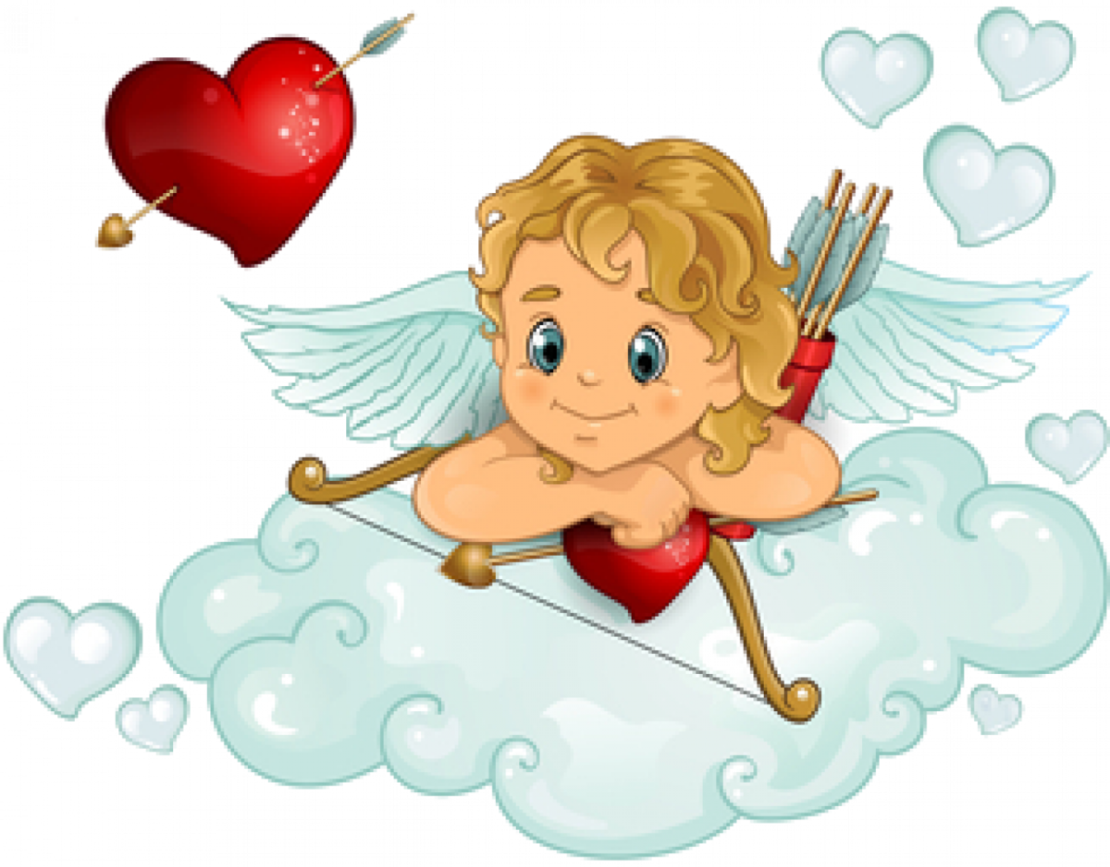

Slide 24
СПАСИБО ЗА ВНИМАНИЕ !!!!

